Slide 1
NESTED IF STATEMENT
A nested if in C is an if statement that is the target of another if statement. Nested if statements means an if statement inside another if statement. Yes, both C and C++ allows us to nested if statements within if statements, i.e, we can place an if statement inside another if statement.

Slide 2
NESTED IF STATEMENT
IF(CONDITION 1)
{
//EXECUTE IF CONDITION 1 IS TRUE
IF(CONDITION 2)
{
//EXECUTE IF CONDITION 2 IS TRUE
}
}

Slide 3
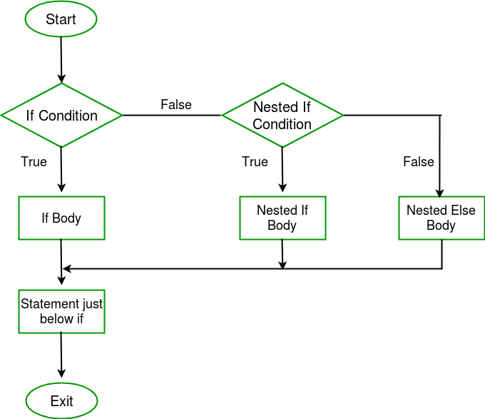
NESTED IF STATEMENT

